Slide 2
Common Cost Share Pitfalls
John Varda, College of Letters & Science
Chelsie Propst, Research & Sponsored Programs

Slide 3

Poll
Notes:
John
Raise your hand if you've been doing research admin for 3+ years; 1-2 years; less than 1 year
Raise your hand if you've done a lot of cost share...a little…or none

Slide 4

Session Overview
Cost Share 101
Cost Share Pitfalls
  Time of Proposal
  Award Acceptance & Setup
  Life of the Award
  End of the Award
Cost Share Tools & Resources
Questions?

Slide 5

Cost Share 101

Slide 6
Introducing Cost Share
Cost Share is when we share the cost of research on a grant by using UW funds to pay for a portion of the project cost.
Cost shared expenses must be paid from UW non-sponsored funds
We must document cost share for our sponsors.
Notes:
John
EXCEPTION: In rare circumstances and with written sponsor permission, 133- non-federal funds may be used as cost share.
Best case is to use salary we’re already going to pay someone on 101-.

Slide 7
Introducing Cost Share: Types
Three Types of Cost Share
Mandatory: the sponsor requires it as a condition of accepting the funding.
Voluntary, Committed: when we offer quantified cost share in our proposal documents or budget. Must be tracked and documented.
Voluntary, Uncommitted: when we offer unquantified cost share in our proposal documents. NOT tracked.
Notes:
John

Slide 8
Introducing Cost Share: Sources
Two Flavors of Cost Share
Payroll Cost Share: when we use UW paid salary as cost share.
Non-Payroll Cost Share: when we use non-payroll expense as cost share.
  Non-payroll Cost Share: non-salary expenses that support the grant.
  Third Party Cost Share: an entity outside UW is providing cost share.
  Unrecovered F&A: sometimes when we use a lower F&A rate, we can count the F&A we would have collected as cost share.
Notes:
John
Payroll cost share: We can schedule it and let it collect pay period by pay period.
Non-payroll: like all cost share must be on non-sponsored fund; must be an expense in WISER
3rd Party: requires a letter from the outside entity documenting the cost share; a cost share update is needed
Unrecovered F&A: will be documented by the RSP post-award accountant

Slide 9
Introducing Cost Share: 2 CFR 200.306
Voluntary committed cost share is not expected/required
Real expense
Allowable, allocable, reasonable, and necessary
Federal funds (144 funding) cannot be used to meet cost share commitments
Included in the approved budget unless not required
Voluntary uncommitted cost share should not be included in research base for indirect cost rate calculations
Notes:
Chelsie
2 CFR 200.306
Often think that offering cost share will make sponsors view proposals more favorably (we can do more with less sponsor funding). Federal regulations prohibit considering voluntary committed cost share (cost share we voluntarily offer to make our proposal more enticing) during the merit review process of applications and proposals (unless treatment of voluntarily committed cost share is explicitly specified in the FOA)
Cost share = real expense. Must be verifiable and documented
Expense must be allowable, allocable, reasonable, and necessary to the award
Federal funds cannot be used to meet cost share commitments
Budgeted cost share supported by Letter of Commitments, important for third-party/subrecipient cost share
Voluntary uncommitted cost share does not need to be tracked, recorded, or reported. Should NOT be reported

Slide 10
Scenario
A PI wants to attend an important conference in Italy. She is looking forward to presenting her findings related to an ongoing sponsored research project. Foreign travel is not allowed to be charged to the award per the terms and conditions, so the PI wants to cost share the trip expenses on the award. Since UW-Madison is paying for the trip instead of the sponsor, there should be no issues with reporting this as cost share.
What is the type and source (flavor) of this potential cost share?
What potential problems do you foresee in this scenario?
Notes:
Chelsie
Points
We don't know the type. Source is non-payroll (would need manual entry)
Main point! - Foreign Travel is not allowable on this award. Since it is an unallowable expense, it is unallowable as cost share.
Other points – is cost share even required on this award? Even if this cost was allowable, we don't report voluntary uncommitted cost share.
Talk to your PIs and department admins to make sure they understand basic guidance on cost share

Slide 11
“Don’t do it!”
Why wouldn't we want to cost share?
Expends UW resources that may be needed elsewhere
Reduces PI flexibility for conducting research
Increases administrative burden across campus
Reduces F&A cost recovery for UW-Madison
Notes:
Chelsie
Cost sharing expends UW resources (time/facilities/funding) on sponsored research, which limits how these resources can be used to support other needs and activities within campus
Restrict PI's flexibility to conduct other research if they are committing effort to specific projects as cost share
Cost sharing is auditable. To reduce to the risk of non-compliance, significant administrative effort may be needed to plan, capture, document, monitor, and report cost share. This is not always an easy task with our current systems
Cost share is included in the research base for F&A rate calculations. The addition of cost share reduces UW's recovery of indirect costs

Slide 12
Risks of Non-Compliance
Sponsor payment delays
Result in disallowed costs
Increased administrative burden
Result in award suspension or termination
May negatively impact other awards across campus
Notes:
Chelsie
During the award
-delay ability to submit invoices or for sponsor payment – we'll talk more about this later
-delay payment of subrecipient invoices (for third-party) - we'll talk more about this later
-increased administrative burden – may need to communicate with sponsor (cost share waiver); need for revised cost share schedules → revised cost share reports
-possible suspension/termination of award
-negatively impact continuation applications
End of award
-may need to return funds to sponsor
-for third-party – UW may need to make up shortfall
-may negatively impact future awards from sponsor
-may negatively impact other awards from sponsor

Slide 13
Keys to Success
#1 Tip - Minimize cost sharing as much as possible!
Carefully consider your cost share sources
Set clear expectations for cost share providers
Engage in proactive monitoring
Maintain sufficient documentation
Notes:
Chelsie
-only cost share when it is mandatory
-avoid concrete dollar amounts for cost share commitments at the time of proposal. If awarded amount is reduced, cost share will likely remain the same
-Payroll is generally the best cost share source since it is already tracked internally. If you
-if relying on other departments/subrecipients/third-party entities to provide cost share, make sure everyone clearly understands what is required from them (sources, amounts, timing, documentation)
-don't wait until the end of an award to make sure cost share is on track! Regularly monitor cost share to catch potential problems early
-make sure all cost share is properly documented (especially important for non-payroll and third-party cost share)

Slide 14

Cost Share Pitfalls

Slide 15
Cost Share Pitfalls
Identify Funding
Proposal Development
Proposal Submission
Award Acceptance & Setup
Award Management
Award Closeout
Time of Proposal
Notes:
John

Slide 16
Cost Share Pitfalls at Time of Proposal
Don’t Cost Share if it’s Not Mandatory!
Do not offer or let your PIs offer quantified voluntary cost share!
Notes:
John
Don’t Cost Share if it’s Not Mandatory.
Admin Burden!
Lowers F&A Rate Calculations.
Do not offer or let your PIs offer quantified voluntary cost share!
Quantified cost share in a proposal budget narrative, scope of work, or elsewhere is Voluntary Committed Cost Share that must be tracked!
It is fine to offer non-quantified cost share.

Slide 17
Cost Share Pitfalls at Time of Proposal
Examples:
  “I’ll work on this project one month each summer.”
  “To ensure success, I’ll devote my free time to this research over the academic year.”
  “10% of Dr. Smith’s 9-month faculty appointment will be spent working on this grant”
  “My research team will make this project a special focus and spend extra time on it whenever they can.”
  “I’ll dream of this research at night and work on it while I sleep!”
Notes:
John
Bad
OK
Bad

Slide 18
Scenario
A PI submits a proposal for $100K in funding to conduct her research. In the proposal, the PI states that she will provide effort equivalent to $10K in salary and benefits. There is no mandatory cost share requirement listed in the FOA. The PI's proposal is accepted, but the sponsor only issues an award for $30K. The award states that UW-Madison will provide $10K in cost share.
What problems do you see in this scenario?
What changes could we make to avoid these pitfalls?
Notes:
Chelsie
Don’t do it!
Don’t quantify
% is better than flat amount

Slide 19
Cost Share Pitfalls
Identify Funding
Proposal Development
Proposal Submission
Award Acceptance & Setup
Award Management
Award Closeout
Award Acceptance
Notes:
John

Slide 20
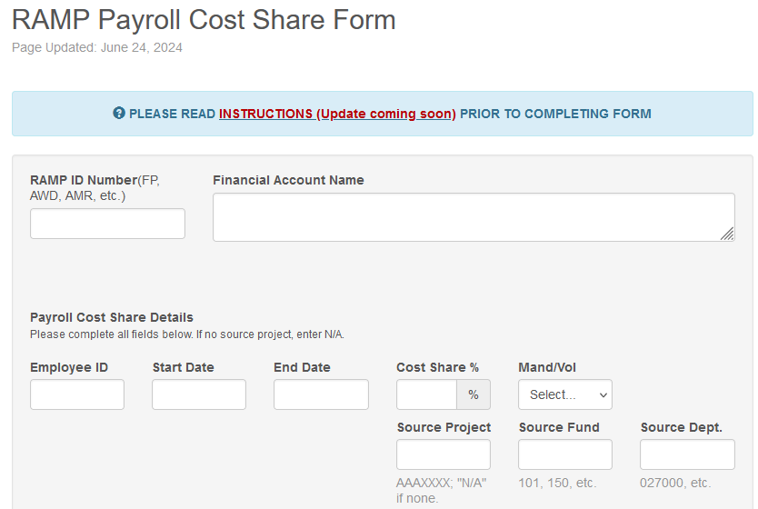
Avoid An Award Set Up Pitfall
BEST PRACTICE
Use the RAMP Cost Share form to schedule payroll cost share when the award is set up.
It won't get done without the form!
You can always update and change the payroll cost share later.
Non-payroll cost share can’t be set up ahead of time.
Risk of effort reopen!
Notes:
John

Slide 21
Cost Share Pitfall: Award Agreement
Confirm award cost share commitment
Review Terms & Conditions
  Special terms related to cost share sources, timing, reporting
Flow-Down Provisions
Prime recipient (UW-Madison) is ultimately responsible for meeting the obligated cost share amount
Notes:
Chelsie
This really begins with the FOA and proposal, but once we get to the award issuance, everything is finalized
-you want to be aware of any special cost share requirements throughout the proposal and negotiation phases
-after award is granted, make sure everything is as expected
-communicate necessary cost share terms to any third party/subrecipient cost share providers

Slide 22
Cost Share Pitfall: Special Term - Cost Share Thresholds
End of the award
Budget Period
  “The Recipient must provide its required “Cost Share” amount as a percentage of the total project costs. [Sponsor] authorized the Recipient to provide cost share on a Budget Period basis.”
Each Invoice
  “The cumulative cost share percentage provide to date on each invoice received must reflect, at minimum, the “Recipient Invoicing Cost Share” percentage specified in the Award.”
Notes:
Chelsie
BP – MSN234911
Invoice – MSN238074
-carefully review the cost sharing requirements in the FOA, during negotiations, and the award terms & conditions.
-make sure you consider the required timing of cost share contributions when setting up cost share schedules and approving subrecipient/third-party budgets

Slide 23
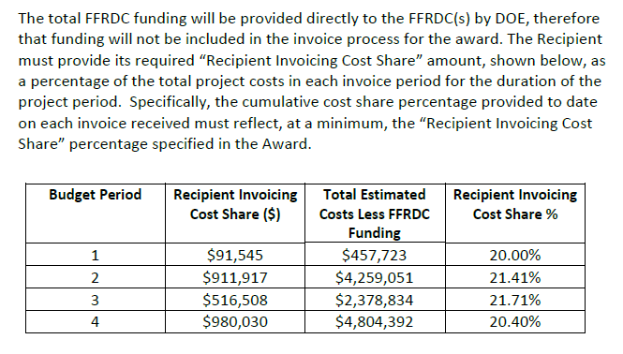
Recipient Invoicing Cost Share Percentage
Notes:
Chelsie
MSN238074
DOE – Energy Efficiency and Renewal Energy (EERE) program

Slide 24
Scenario
We received an award for $80K over 4 years ($20K/yr). We have a total cost share obligation of $20K. Fortunately, our subrecipient will be providing 50% of the cost share ($10K) in the final year of the award. UW plans to meet the remaining $10K cost share obligation with payroll cost share during years 2-4.
Per the award terms and conditions, we are required to show cost share of at least 20% of our total costs on each invoice.
What potential problems do you foresee in this scenario?
What changes could we make to avoid these pitfalls?
Notes:
Chelsie
Probably won’t be able to invoice for first few years
Need to shift majority of UW cost share to year 1
Keep term in mind when constructing budgets

Slide 25
Cost Share Pitfalls
Identify Funding
Proposal Development
Proposal Submission
Award Acceptance & Setup
Award Management
Award Closeout
Life of the Award
Notes:
John

Slide 26
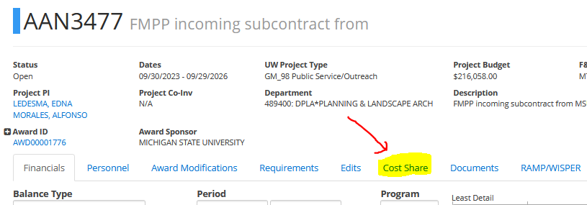
Mechanics of Cost Share – Payroll Schedules
Our system is finicky!
  Payroll cost share schedules require careful set up and periodic monitoring.
  Use the cost share tab in WISER frequently to check progress.
Notes:
John

Slide 27
Mechanics of Cost Share – Payroll Schedules
Our system is dumb!
The cost share system looks at every pay period for payroll cost share and needs us to check on it to make sure it works.
If someone's salary sources change, you will need to submit a payroll cost share update to reflect those changes.
Notes:
John
Our system is dumb!
It only knows exactly what we told it to look for. If payroll changes, we need to change the cost share schedule.
The cost share system looks at every pay period for payroll cost share, and:
If the percentage of salary paid on the cost share source goes below the cost share percentage it's looking for it will fail.
cost share reads 2 decimal places, and you must round down the larger HRS payroll decimals.
if the person's salary sources change, the cost share system won't know and will fail looking for the old cost share source

Slide 28
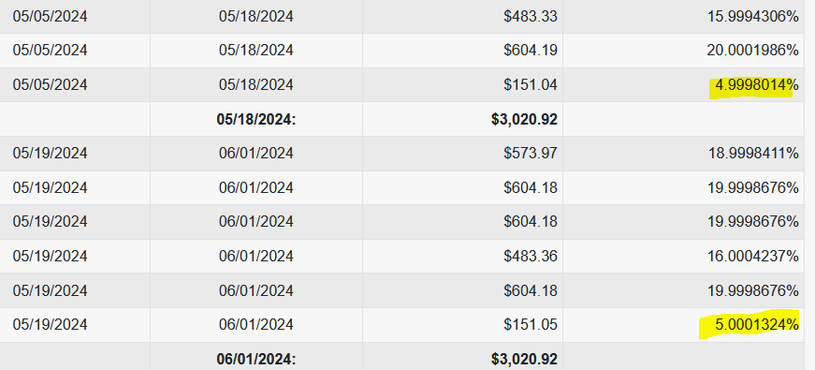
Cost Share Percentage Pitfall Personified
Notes:
John
Here’s an example of someone’s payroll funding splits. They’re set up at 5% on a non-sponsored source represented in the final row of funding. If we set the cost share at 5%, it will bomb!

Slide 29
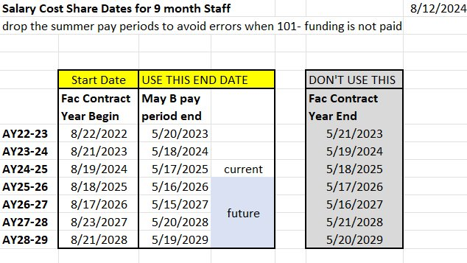
Avoid a Common 9-month Payroll Cost Share Problem
Payroll cost share schedules for 9-month faculty should not include summer months.
Cost share will fail if you try to collect from 101- over the summer.
Notes:
John
This schedule aligns with the 9-month dates. 2nd week of Aug A and the end of May B biweekly pay periods.

Slide 30

9-month Payroll Cost Share: Bad and Good
101
101
101
Notes:
John
Top row will fail for c-basis faculty; bottom two rows are corrected

Slide 31
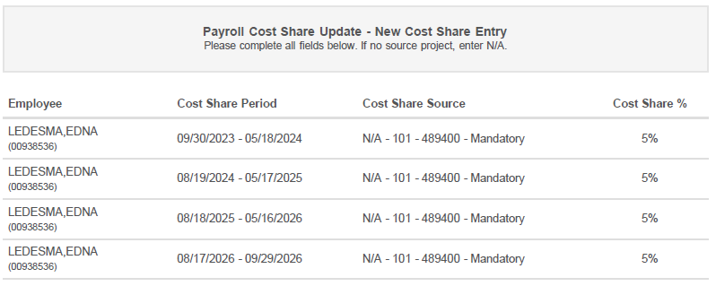
9-month Payroll Cost Share – Good Example
Notes:
John
Here’s an example of a multiyear schedule for a faculty member.

Slide 32
Monitor Payroll Cost Share to Avoid Errors
The system is finicky and dumb, don’t assume it worked the way you wanted!
Cost share needs monitoring, go into the WISER cost share tab regularly to check your cost share schedules and expenditures.
Some payroll cost share errors will display in the cost share schedule area, others will not.
Click into the payroll cost share expenditure detail to ensure cost share is collecting as expected pay period by pay period.
The week after you’ve submitted a cost share update form, check that your update worked as expected.
Notes:
John

Slide 33
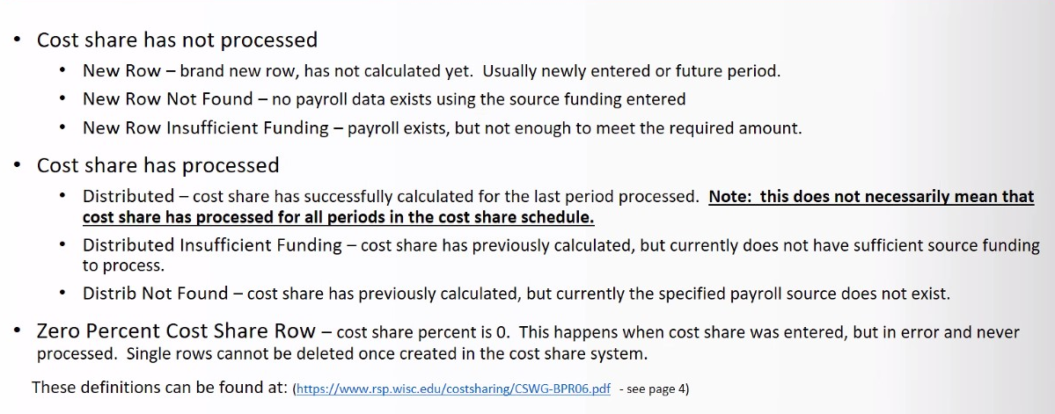
Distribution Status Definitions
Notes:
John
NOT GOING TO READ ALL OF THESE, you can find the definitions in the cost share update instruction pdf
BUT: want you to be aware that even though you get the DISTRIBUTED message, you still need to check that all the periods in the schedule processed by clicking into the detail in the Expenditures section that Chelsie will show next.

Slide 34
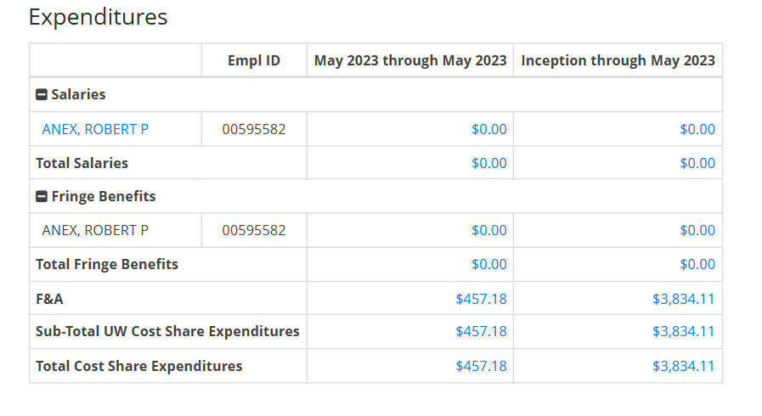
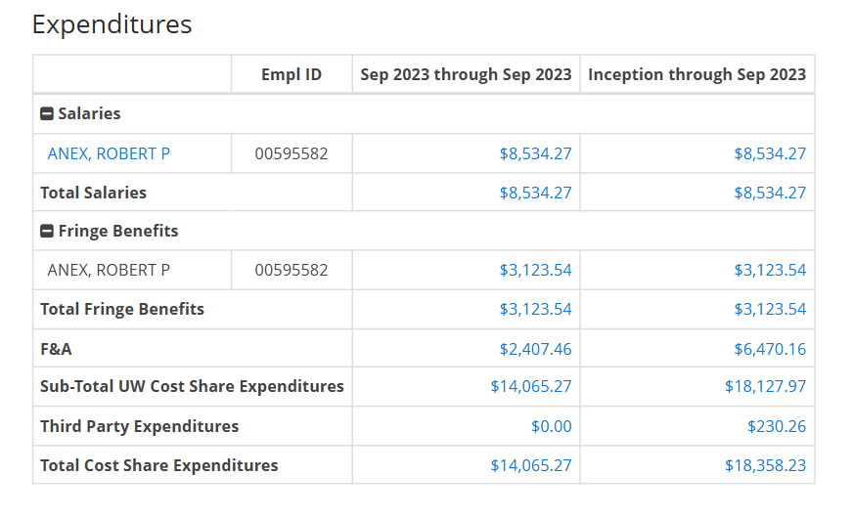
Cost Share Pitfalls during the Life of the Award: Payroll Schedule Changes and Reporting
Notes:
Chelsie
Example – MSN264366
-varies by sponsor and award (terms & conditions)
-reported by RSP post-award
-may require monthly reporting
-if cost share schedules are changed mid-schedule, notify your RSP post-award accountant as this may impact cost share reporting
-even if reporting is NOT required, we still must meet the cost share commitment and department must keep supporting documentation

Slide 35
Effort and Payroll Cost Share – Avoid Snags
Payroll cost share is related to effort and effort reporting/ECC.
  Effort reporting is an opportunity to see cost share problems, take advantage.
  Be mindful when pre-reviewing effort cards that include (or SHOULD include) cost share.
  Catching payroll cost share errors during the effort certification period will save you time and trouble later.
CATCH Payroll Cost Share errors before the effort period closes!
  Most effort cards can be put on hold past the effort deadline if cost share updates are needed or are in progress to allow the update to post prior to certification.
Notes:
John
Payroll cost share is related to effort and effort reporting/ECC
Effort reporting is an opportunity to see cost share problems, take advantage.
Be mindful when pre-reviewing effort cards that include (or SHOULD include) cost share.
Catching payroll cost share errors during the effort certification period will save you time and trouble.
CATCH Payroll Cost Share errors before the effort period closes!
Payroll cost share fixes that involve closed effort card need special reopen request and are audit red flags.
n

Slide 36
Tips for Fixing Payroll Cost Share
If you need to update cost share because it's not collecting as expected:
  Use the effort payroll tool to help create useable payroll cost share schedules when the salary has already posted.
  If you must make significant changes to old payroll cost share schedules, you may need to reopen old effort cards.
  Carefully prepare your payroll cost share forms according to the instructions linked to the online form.
Notes:
John

Slide 37
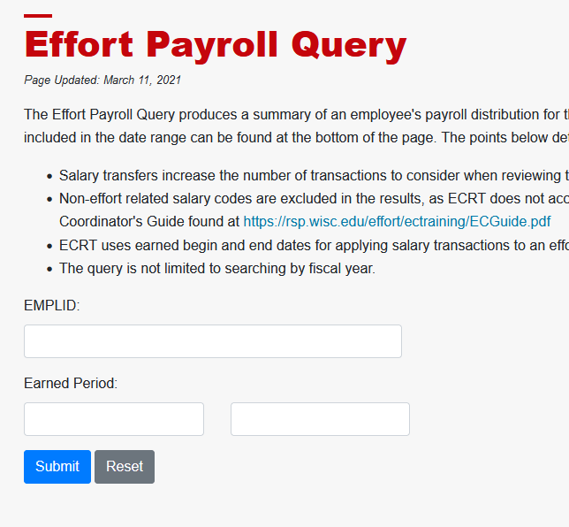
Fixing Payroll Cost Share Problems?
Use Effort Payroll Query
Notes:
John
Great tool; can only provide info on posted salary.

Slide 38
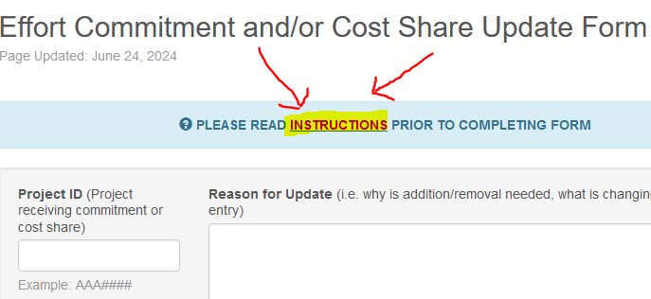
AVOID REWORK – Use the Instructions!
BEST PRACTICE
Click the Instructions link in the entry form page of the Cost share update form.
Use those PDF instructions and avoid send backs and rework!
Notes:
John
-lead into non-payroll cost share

Slide 39
Non-Payroll Cost Share: Overview
Supplies
Travel
Equipment
Student Hourly salary (if allowed)
Tuition Remission (if allowed)
Notes:
Chelsie
-can only claim as cost share after expense has been recognized in the system
-cost must be allowable and allocable to the award
-manual entry by RSP
-visible on WISER cost share tab (typically next day after entry)

Slide 40
Non-Payroll Cost Share Concerns
Non-payroll cost share can only be documented after it has been expended.
You must find the WISER expense rows in order to document the non-payroll cost share.
  It's easy to forget to do this!
  It’s easy to forget where the expense rows posted!
Notes:
John
You must find the WISER expense rows in order to document the non-payroll cost share. It's easy to forget to do this!
Set reminders to review cost share and add non-payroll cost share
Keep track of where those cost shared expenses are posted, you will need to find the expense in WISER
Follow the instructions when creating the cost share expenditure spreadsheet

Slide 41
Non-Payroll Cost Share Concerns - Shortfalls
If someone is not going to come through, you will need to MAKE UP THE DIFFERENCE (yikes!)
DON’T WAIT UNTIL THE LAST MINUTE!
If other entities are providing cost share, SET EXPECTATIONS when the award is made.
  Others may not have the same feeling of responsibility to fulfill the requirements because the cost share is not their problem.
Notes:
John
If other UW units are providing non-payroll cost share, keep in touch
If non-UW entities are providing third party cost share, keep in touch
If you have other departments, divisions, or outside entities providing cost share, BE SURE TO SET EXPECTATIONS when the award is made
Make sure those entities KNOW they are responsible for documenting the cost share they've promised.
Others may not have the same feeling of responsibility to fulfill the requirements

Slide 42
Cost Share Pitfall: Third-Party Cost Share
Who is a third party?
  Subrecipients
  External entities
  UW zero-dollar appointees
Alleviates UW-Madison of financial burden of cost sharing
PI must ensure third party understand cost share obligations
UW-Madison must cover any shortfall!!!
Increased administrative burden
Notes:
Chelsie
-subrecipient/third –party cost share is appealing – UW doesn’t have to pay!
-PI should ensure that the subrecipient understands what cost share is, especially if they are an organization that may not be familiar with the concept
-as prime recipient, UW is ultimately responsible for meeting cost share obligations when a subrecipient falls short
-if prime award has cost share invoicing thresholds (from previous slide), consider these thresholds when working on subrecipient budgets & cost share during the proposal/negotiation phases
-increased administrative burden (we must confirm and track subrecipient cost share commitments; this cost share must be manually entered into the system)
-visible on WISER cost share tab (typically next day after entry)

Slide 43
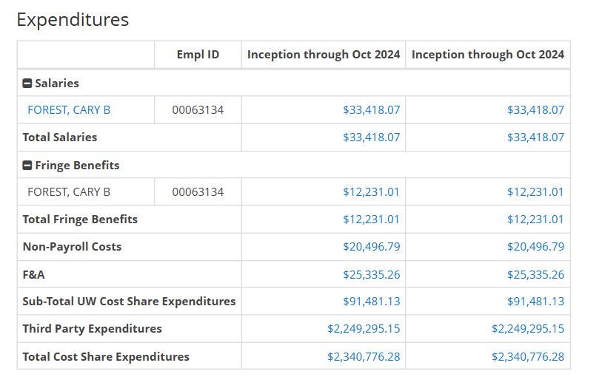
WISER Cost Share Tab
Notes:
Chelsie
Example of several types of cost share in the cost share tab in WISER
-payroll
-non-payroll
-third-party

Slide 44
Scenario
The end-date of our award is quickly approaching, and we have not met our cost share commitment. The PI mentions that the cost shared service provided by our subrecipient should be valued much higher than was outlined in the subrecipient's Letter of Commitment. To resolve our cost share shortage, the PI suggests that we increase the reported cost share amount from the subrecipient to reflect what it would cost UW-Madison to do the same task.
What potential problems do you foresee in this scenario?
What changes could we make to avoid these pitfalls?
Notes:
Chelsie
-Cost share has a specific valuation based on Letter of Commitment provided by sub and by their provided cost share reports
-We can't just arbitrarily change the value of the cost shared item/service.
-We may selected this sub specifically because they were better equipped to provide this item/service (at a lower cost) than we were
-we will need to find other source for the cost share
-if the PI truly believes there is an error with the cost share valuation (this should have been addressed during the proposal/negotiation phase), it should first be discussed with subrecipient, a new letter of commitment will be drafted and approved, then LOC will need to be sent to sponsor for approval, then we can provide an updated cost share report to sponsor

Slide 45
Cost Share Pitfalls
Identify Funding
Proposal Development
Proposal Submission
Award Acceptance & Setup
Award Management
Award Closeout
End of the Award
Notes:
Chelsie
Best practice is to be proactively monitoring cost share and avoiding common mistakes so that there are no surprises at the end

Slide 46
Cost Share Pitfalls at the End of an Award
We are not meeting our cost share commitment
  Update previous payroll schedules
  Need to make up for third-party cost share shortfall
  Look for other potential sources of cost share
  May need to return funds to the sponsor
We have cost shared more than required
  Voluntary Uncommitted cost share is NOT reported to the sponsor
Maintain documentation for potential future audits
Notes:
Chelsie
How do we address cost share shortages at the end of the award?
Source of cost share does not typically matter to the sponsor as long as it is allowable/allocable/etc to the award
Want to avoid needing to update old payroll cost share schedules because we may need to repopen effort cards
If we can't meet our cost share obligation, we may need to return funds to the sponsor. (ex. 20% cost share obligation, return funds so that our final cost share = 20% of funding)
We do not report excess cost share to the sponsor. If the PI wants to mention this in a final report, do not quantify it

Slide 47
Cost Share Tools & Resources
WISER – Cost Share Tab
RED Cost Share Course: https://rsp.wisc.edu/training/
RSP Cost Share Guidance: https://rsp.wisc.edu/costsharing/
Cost Share Update Form: https://rsp.wisc.edu/forms/costshareCommitment_update/index.cfm
Cost Share Update Instructions: https://rsp.wisc.edu/costsharing/UpdateFormInstructions.pdf
Effort Payroll Query: https://login.wisc.edu/idp/profile/SAML2/Redirect/SSO?execution=e1s2
Uniform Guidance (2 CFR 200) on Cost Share: https://www.ecfr.gov/current/title-2/subtitle-A/chapter-II/part-200/subpart-D/section-200.306

Slide 48
Looking ahead to Workday – Progress & Pitfalls
Cost Share in Workday will be completely different
In Workday, we will create a cost share project that will collect cost share expenditures in real time and display them in a similar fashion to regular grant expenditures.
Cost share set up will be different and perhaps a challenge?
  Payroll cost share schedules will not be part of Workday.
Notes:
John
Cost share set up will be different and perhaps a challenge:
When setting up cost shared salary or paying non-payroll expenses that will be cost shared, we will need to enter the project receiving the cost share along with the non-sponsored funding source.
There will be no way for Workday to know that the salary or expense needs to be cost shared. Ancillary System needed??
If we forget to enter the project that we are cost sharing to, only a cost transfer will fix it.

Slide 49
Questions?
John Varda: john.varda@wisc.edu
Chelsie Propst: chelsie.propst@rsp.wisc.edu

